Slide 1
EE 521/ECE 582 – Analysis of Power systems
Class #5 – September 8, 2022
Dr. Noel N. Schulz
Edmund O. Schweitzer III Chair in
Power Apparatus and Systems
Chief Scientist Joint Appointment, PNNL
Co-Director, PNNL/WSU Advanced Grid Institute (AGI)
Washington State University Pullman
Noel.Schulz@wsu.edu EME 35
509-335-0980 (o) and 509-336-5522 (c)

Slide 2
Here are my office hours via zoom and in-person as possible. I will let you know when I am in each location
Tuesdays 4:30-5:30 pm (after class)
Wednesdays 4-5 pm
Fridays 1:30-2:30 pm
Below is the zoom information for the semester! I will also set other times to go over your code individually.
Join from PC, Mac, Linux, iOS, or Android: https://wsu.zoom.us/j/8237216735 (Links to an external site.)
Meeting ID: 823 721 6735

Slide 3
Programming Projects: (80%)
Power Flow Project (20%)
Y_{bus}, Jacobian matrices – Newton Raphson
LU Factorization, Backward-Forward substitution for NR
Fast Decoupled
Q-limits, transformer taps
Using IEEE 14 bus system as given, and I will provide a slightly modified version after you confirm the 14-bus system.
Projects build on each other, adding different features
In addition to getting the right answers, for each program we’ll set up a session for you to describe your code to me.
Copying code from a colleague or from on-line resources is not permitted.

Slide 4
Newton-Raphson and Parts
Input Data
Calculate Jacobian Terms
Calculate Y_{bus}
Solve Equation [A][x] = [b]
Calculate Jacobian Terms
Calculate Mismatch]
_{Iterative Solution}
Check Mismatch?
Small enough
Output Results
Output Results

Slide 5
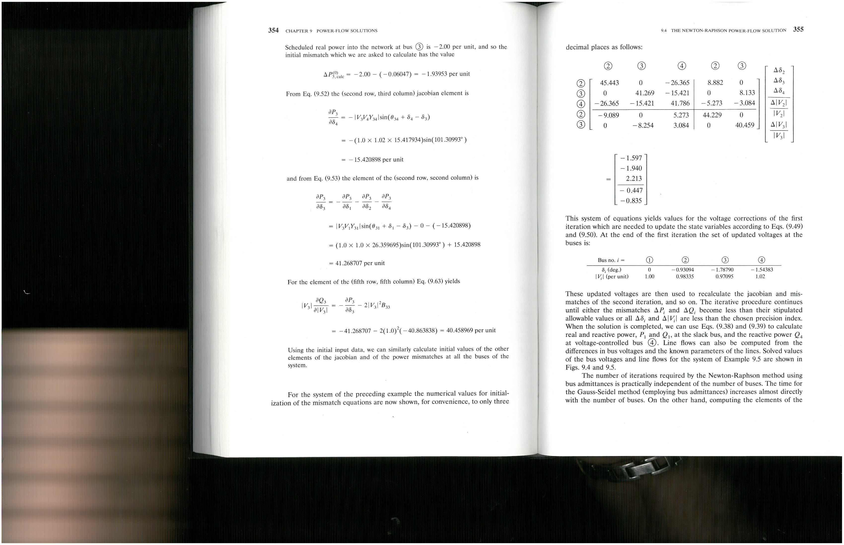
Solving the Matrix once you calculate it
An elementary row operation is one of the following:
Interchange any two rows of the matrix
Multiply any row by a constant
Take a linear combination of rows and add it to another row

Slide 6
Gaussian Elimination for solving Ax=b
is the process of using a series of elementary row operations to convert:
Identity matrix
An elementary row operation is one of the following:
Interchange any two rows of the matrix
Multiply any row by a constant
Take a linear combination of rows and add it to another row
solution

Slide 7
Basic Approach to Gaussian Elimination
Upper Triangularize (i.e. zero out all elements below the diagonal) using elementary row operations (EROs)
Then back substitute to find solutions
(EROs)
All zeros below diagonal

Slide 8
ERO(4)
Scale diagonal a₁₁ to 1
(in this case ERO(4) = identity since a₁₁ is already 1)
Update A by EROs 1 through 4
ERO(4)
ERO(3)
ERO(2)
ERO(1)
A
A’
All zeros

Slide 9
Update A’ by EROs 5 through 7
ERO(7)
ERO(6)
ERO(5)
A’
A’’
All zeros
Now eliminate third column
A’’’
And diagonalize
ERO(8)
ERO(9)

Slide 10
A’’’
Normalize to 1
ERO(10)
Multiply b by EROs 1 through 10:
ERO(10)ERO(9)ERO(8)…ERO(1)b = b’’’’ =

Slide 11
Now we can use back substitution to find x₁, x₂, x₃, and x₄
x*

Slide 12
LU Factorization
LU Factorization is an extension of Gaussian elimination in that the forward triangularization process is formalized such that the matrix A is factorized into an upper triangular matrix (U) and a lower triangular matrix (L) such that
So how does this help us solve Ax=b?

Slide 13
Note that Ax=b implies that LUx=b. If we introduce a “dummy” variable y such that y=Ux, then
Since L is lower triangular, then it is easy to solve for y!
This is forward substitution.
And once we have y, then we can solve Ux=y, where U is upper triangular.
This is backward substitution.

Slide 14
Let
U
Note that U has ones (1) on the diagonal
L
Q will be calculated first by column and then by row
Q =

Slide 15
Initialize Q to the zero matrix. Let j=1.
Complete the j^{th} column of Q (j^{th} column of L) as
If j=n, then stop.
Assuming that q_{jj} ≠ 0, complete the j^{th} row of Q (j^{th} row of U) as
Set j=j+1. Go to step 2.
Crout’s algorithm for computing LU from A
Note that Q overwrites A, thus they can both be stored in the same matrix!

Slide 16
Example: To find q₅₅:

Slide 17
Similarly: To find q₆₅:

Slide 18
Example: Find the LU factors of the A matrix
Let j=1, then from we get and the first column of Q is just the first column of A:
For the first row of Q, we use
from which
3
4
8

Slide 19
Second column ( j = 2):
q₂₂ = a₂₂-q₂₁q₁₂ = 1-(2)(3) = -5
q₃₂ = a₃₂-q₃₁q₁₂ = 3-(4)(3) = -9
q₄₂ = a₄₂-q₄₁q₁₂ = 2-(9)(3) = -25
Second row:

Slide 20
Third column ( j = 3):
Third row:

Slide 21
Fourth column ( j = 4)
Check: LU=A?
✓

Slide 22
Solve
Solve Ly = b using Forward substitution
2. Solve Ux=y using Backward substitution
Note that this is exactly the same backward substitution that we had for Gaussian Elimination!

Slide 24
Challenges Solving Problems with Computers
Numerical things to think about when solving on the computer
What is zero?
What is good enough when solving?
Now do the magnitude relationships affect our results?

Slide 25
Partial Pivoting for LU factorization
Solve
We can estimate that the solution to this system will be:
Find LU factors:

Slide 26
Solve for y:
Solve for x:
This cannot be correct!
It should be x₁ ≈ 2
What happened?

Slide 27
The problem is that 10⁻¹⁰ is too close to zero for most computers (and human) accuracy, essentially leading to a “divide by zero” problem
We can fix this error by rearranging the equations:
The LU factors are:
Resulting in:
Then:
Much better!

Slide 28
We can introduce a pivoting strategy to move the largest element to the diagonal to avoid any potential divide by zero problems
Partial Pivoting Strategy
At the j^{th} step of the LU factorization, choose the k^{th} row as the exchange row such that
Exchange rows and update A, P, and Q correspondingly
What is P?

Slide 29
P is a permutation matrix that reflects any row interchanges that have occurred during partial pivoting. P starts as the identity matrix.
Swap rows

Slide 30
Repeat previous example with partial pivoting.
Calculate first row and second column of Q
Calculate second row and third column of Q
Calculate third row and fourth column of Q
Calculate first column of Q
This is the largest element in the first column.
This is the largest element in the third column, so no pivot required.
This is the largest element in the second column.
Swap row 2 and 4
Swap row 1 and 4

Slide 31
How is P used?
Start with
Premultiply both sides by P :
Substitute:
Solve:
This is just a reordered b vector
Then: (same as usual. The order of x remains unchanged.)

Slide 32
Complete Pivoting for LU factorization
In some cases, complete pivoting is used in which the largest element remaining (rather than in just the column) is pivoted to the diagonal element.
This requires both a column and row pivot.
In this case, two permutation matrices are developed such that
Then (as before)
Now define P₂ z = x, then
Solve for z, then x = P₂ z.
The vector z has the same values as x, just in a different order.
The action P₂z reorders the values back to the original order.

Slide 33
Initialize Q to the zero matrix. Let j=1.
Complete the j^{th} column of Q (j^{th} column of L) to the j^{th} column of the reduced matrix A^{(j)}, where A⁽¹⁾=A and
If j=n, then stop.
Assuming that q_{jj} ≠ 0, set the j^{th} row of Q (j^{th} row of U) as
Update A^{(j+1)} from A^{(j)} as:
Set j=j+1. Go to 2.
Gauss’ algorithm for computing LU from A

Slide 34
Stationary Iterative methods for solving Ax=b:
Iterative methods generate a sequence of approximations to x* from an initial guess (i.e. x⁰, x¹, x², … x^{k} ) such that x^{k} → x* as k → ∞.
If convergent¹, these methods are accurate to within a user-defined convergence criterion.
Examples include:
Gauss Jacobi
Gauss Seidel
Successive Over-Relaxation
¹ we’ll discuss convergence later

Slide 35
Relaxation methods for solving Ax=b:
Start with Ax = b
Define a matrix M such that:
Rearranging:
Adding iteration indices:
The choice of M determines if, and how fast, Ax – b → 0.
When , for some small ε, then the iteration is said to have converged.

Slide 36
Jacobi
Let M = D (the diagonal elements of A), then
Or in scalar form:
This method is attractive for parallel processing applications because each depends only previous values of x^{k}. Thus each i^{th} element can be calculated independently.

Slide 37
Solve using the Jacobi method.
Set up the equations:

Slide 38
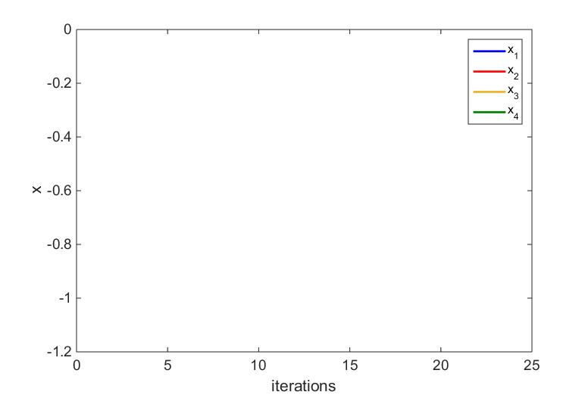
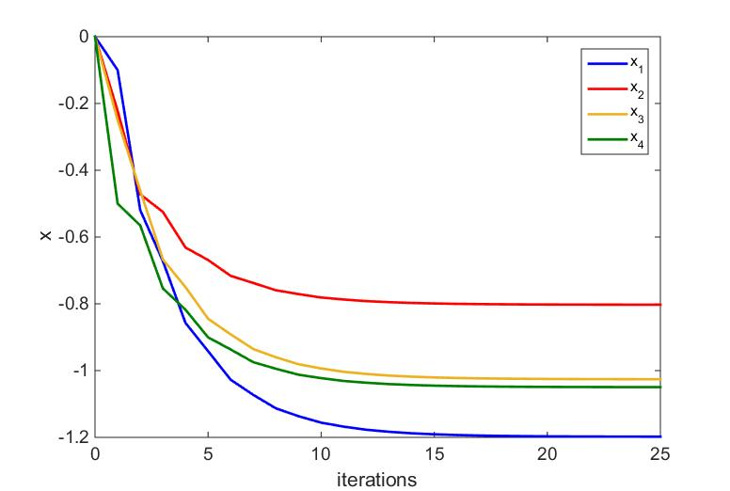
Jacobi
-0.8026
-1.0258
-1.0494
-1.1978

Slide 40
Solve using the Gauss-Seidel method.
Set up the equations:

Slide 41
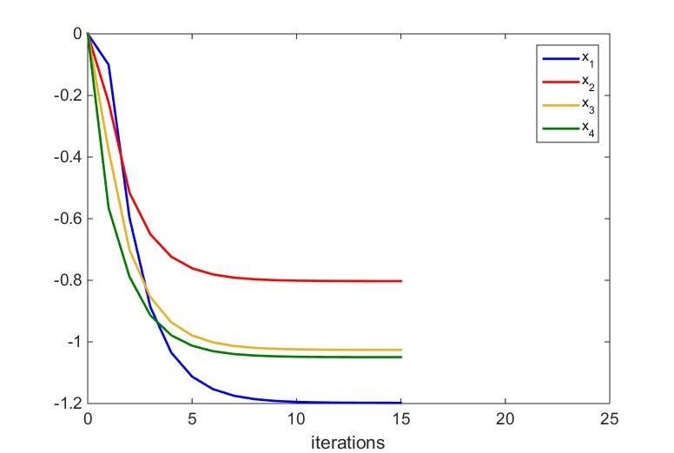
Gauss-Seidel
-0.8026
-1.0258
-1.0494
-1.1978

Slide 42
Jacobi
Gauss-Seidel

Slide 43
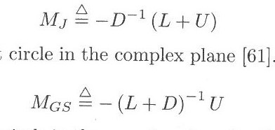
The Gauss Seidel method took fewer iterations to converge than did the Gauss Jacobi method.
Is it possible to predict if, and how fast, a method may converge?
Consider the matrices M_{J} and M_{GS}. If all of the eigenvalues of M_{J} or M_{GS} lie within the unit circle in the complex plane, then the iteration will converge for any initial guess.

Slide 44
eig(M_{J})=
Convergence guaranteed!
eig(M_{GS})=
Convergence guaranteed!

Slide 45
Consider now the Jacobi method applied to the following system of equations:
(used previously in LU factorization example)

Slide 46
Iterations will not converge
Not converging!

Slide 47
Successive Overrelaxation
The Gauss-Seidel iteration
can be rewritten as:
Upper triangular part of A
(not the U from LU factorization)
Add a weighting factor 0 < ω < 2:
If ω = 1, then the method reduces to the Gauss-Seidel.
For large systems, this method can potentially converge much more rapidly than
either Jacobi or Gauss-Seidel, but it is difficult to find an optimal value of ω

Slide 48
Newton-Raphson and Parts
Input Data
Calculate Jacobian Terms
L-U Factorization
Calculate Y_{bus}
Solve Equation [A][x] = [b]
Backward/ Forward Substitution
Calculate Jacobian Terms
Calculate Mismatch]
_{Iterative Solution}
Check Mismatch?
Small enough
Output Results
Output Results

Slide 49
Programming Projects: (80%)
Power Flow Project (20%)
Y_{bus}, Jacobian matrices – Newton Raphson
LU Factorization, Backward-Forward substitution for NR
Fast Decoupled
Q-limits, transformer taps
Using IEEE 14 bus system as given, and I will provide a slightly modified version after you confirm the 14-bus system.
Projects build on each other, adding different features
In addition to getting the right answers, for each program we’ll set up a session for you to describe your code to me.
Copying code from a colleague or from on-line resources is not permitted.

Slide 50
Reminder
Here are my office hours via zoom and in-person as possible. I will let you know when I am in each location
Tuesdays 4:30-5:30 pm (after class)
Wednesdays 4-5 pm
Fridays 1:30-2:30 pm
Below is the zoom information for the semester! I will also set other times to go over your code individually.
Join from PC, Mac, Linux, iOS, or Android: https://wsu.zoom.us/j/8237216735 (Links to an external site.)
Meeting ID: 823 721 6735

Slide 51
Announcements
Review examples from Chapter 2
Read Sections 3.1 and 3.2
Working on MATLAB Program
Input the CDF file – Start with Data in Program
Start working on building the Ybus
Calculate Jacobian Matrix Values
Work on LU Decomposition

